Slide 1

Notes:
Good afternoon! My name is _________ with the United States Navy.
Today I’m going to tell you about the Navy’s Nuclear program — the most advanced program in the military.

Slide 2


2
NICE TO
MEET YOU
[Insert Recruiter background/
contact information]
Notes:
I’m a recruiter with the U.S. Navy and want to introduce you to the Navy and what it has to offer.
INCLUDE ON SLIDE:
Name
Phone Number
Social Channels

Slide 3
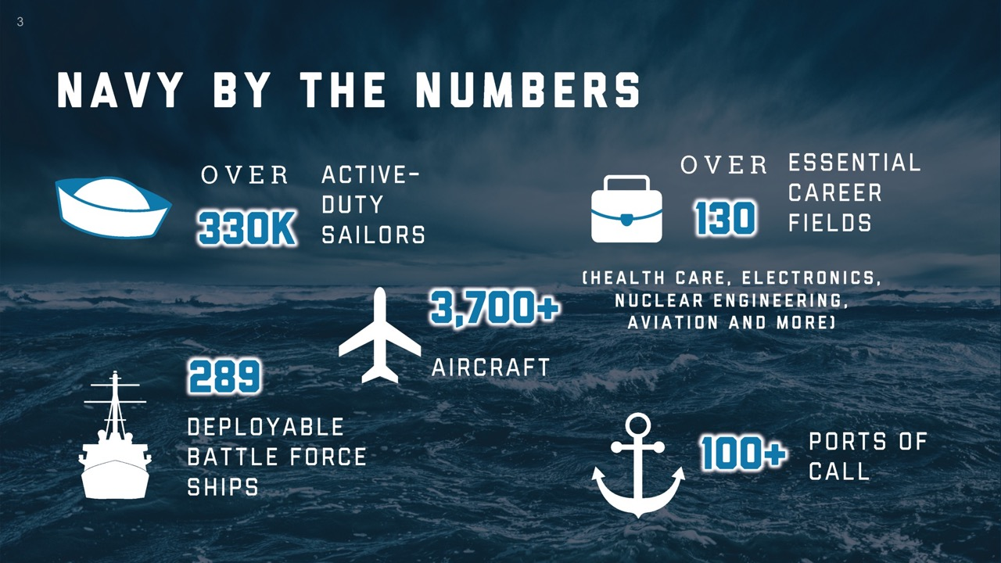
Notes:
The Navy was founded in 1775.
One of 7 uniform services in the United States and 1 of 5 armed forces.
Largest Navy in the world, greater than the next 13 navies COMBINED, with over 330,000 active-duty Sailors and over 130 essential career fields.
World’s largest aircraft carrier fleet, including 289 deployable battleships and over 100 ports of call.

Slide 4
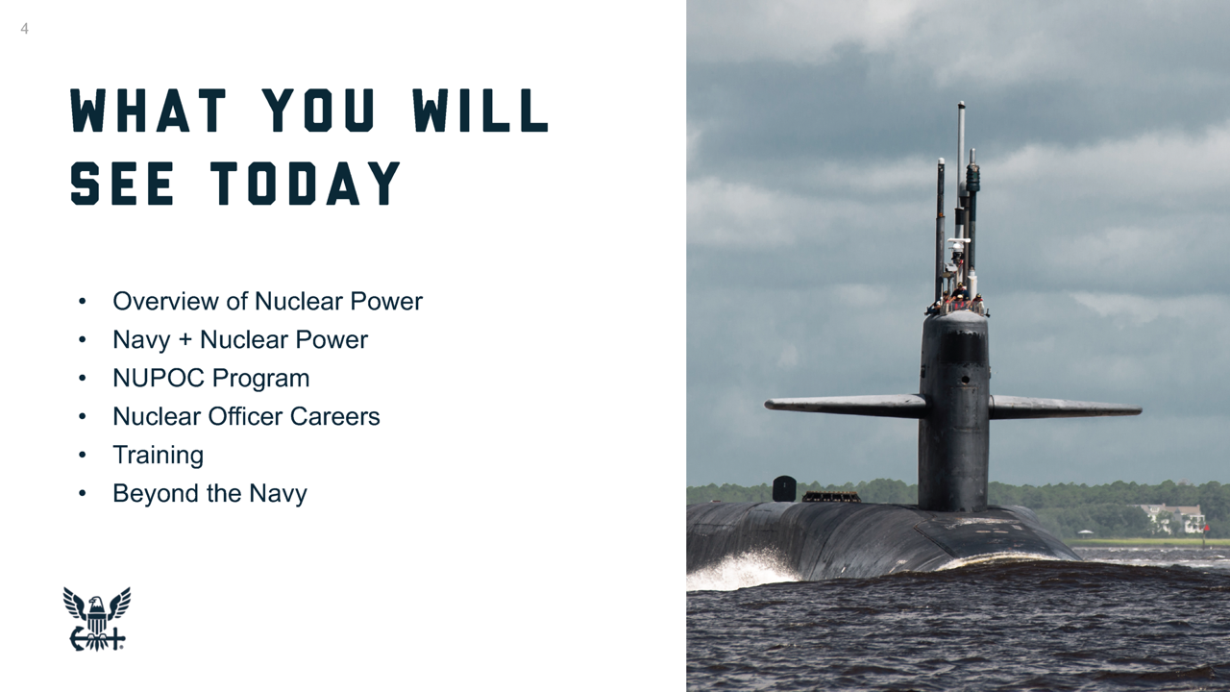

Slide 5
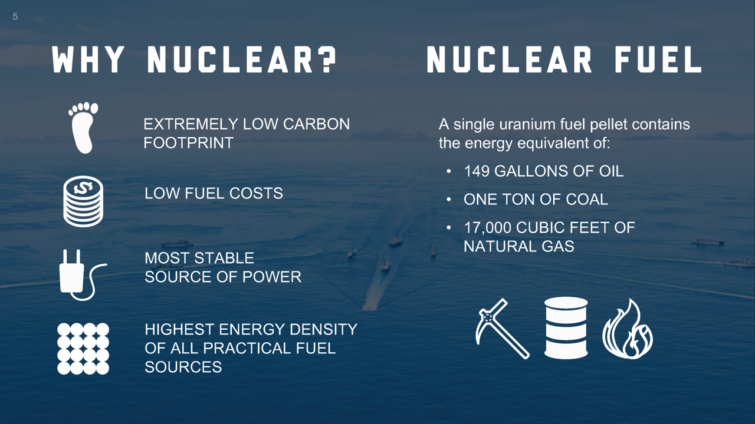

Slide 6
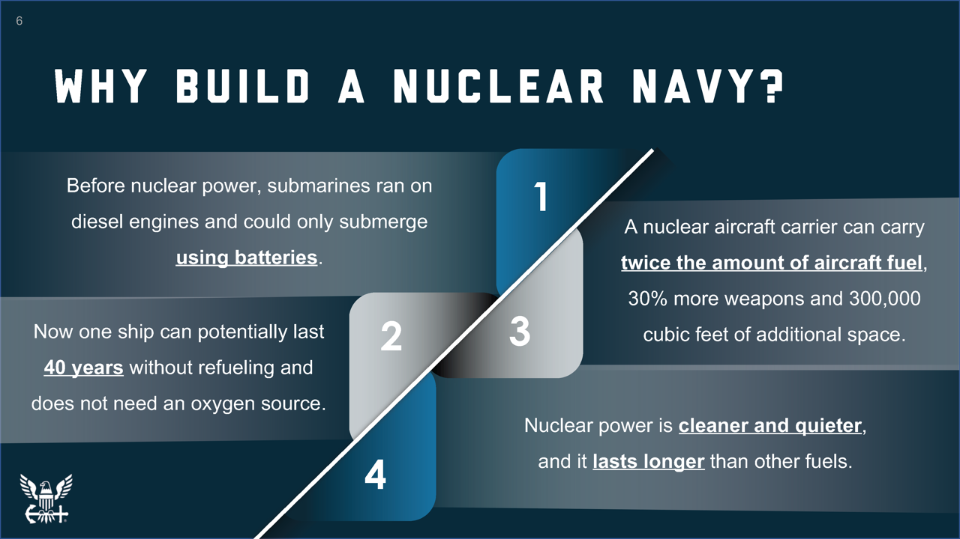

Slide 7
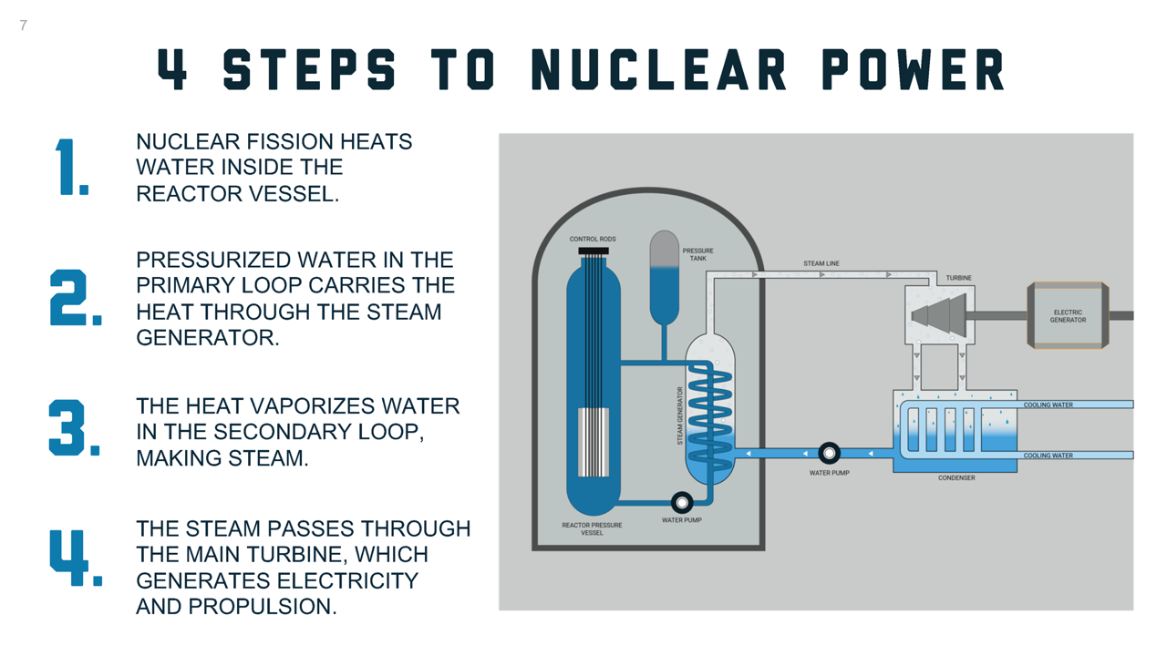

Slide 8
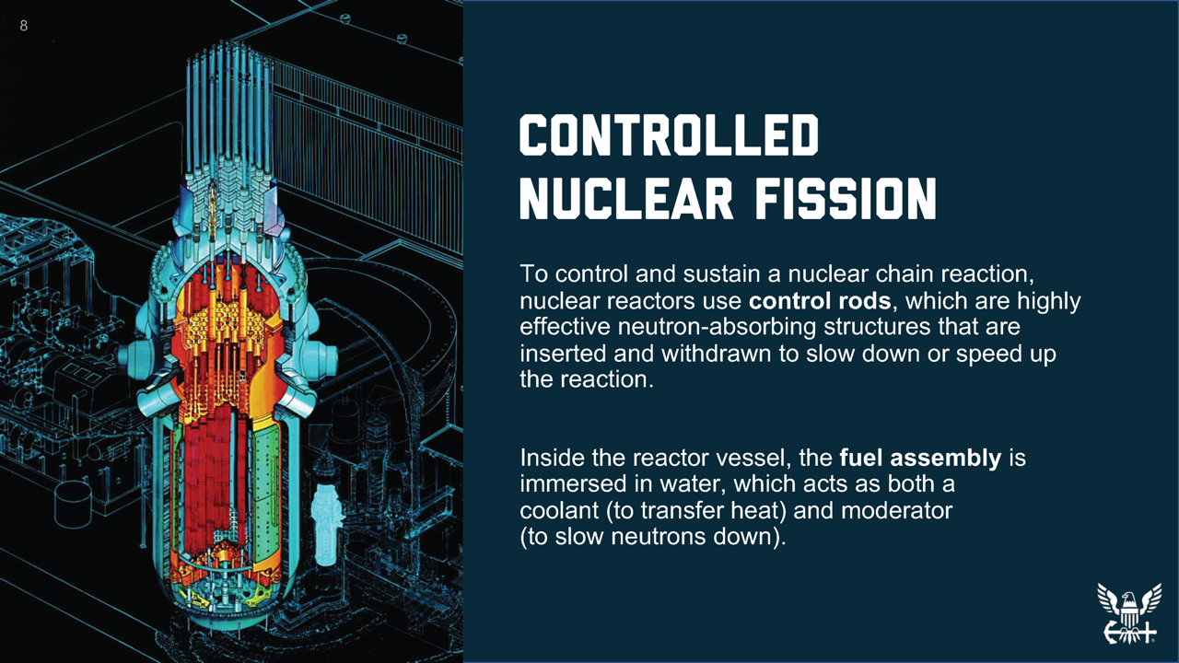
Notes:
This is an image of a nuclear reactor vessel. It can speed up or slow down the reaction as needed.
Control rods are in yellow and can be made of boron, silver, indium, and cadmium. They are inserted and withdrawn to control the speed of the reaction.
Fuel assembly is in red. Remember, that’s where uranium pellets were loaded.
Fuel assembly acts as a coolant and moderator.
Now that we’ve discussed fission and how we control it, we are going to look at the four steps to creating nuclear power.

Slide 9
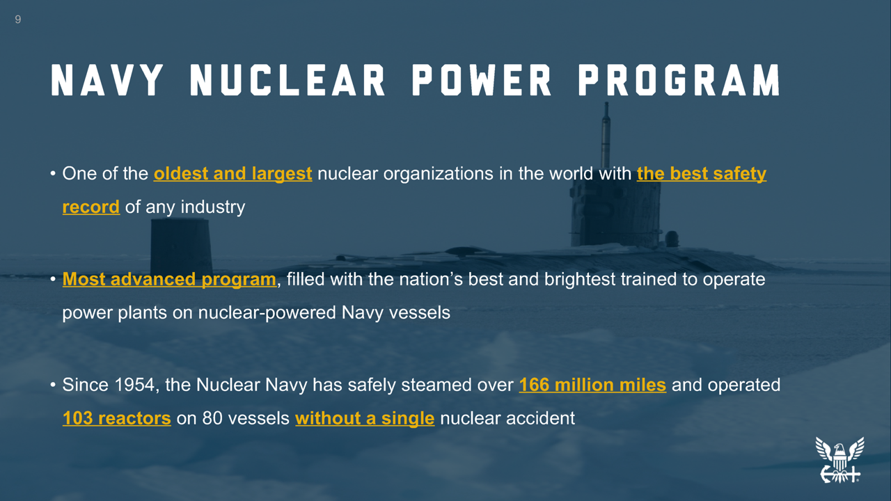
Notes:
The Navy nuclear power program has a long, proud history. It is one of the largest nuclear organizations and one of the most advanced programs in the world.
The Navy has a stellar safety record when it comes to nuclear power.
The Navy has sailed 166 million miles without a single nuclear accident, which is approximately 6,666 trips around the world or approximately 345 round trips to the moon.

Slide 10
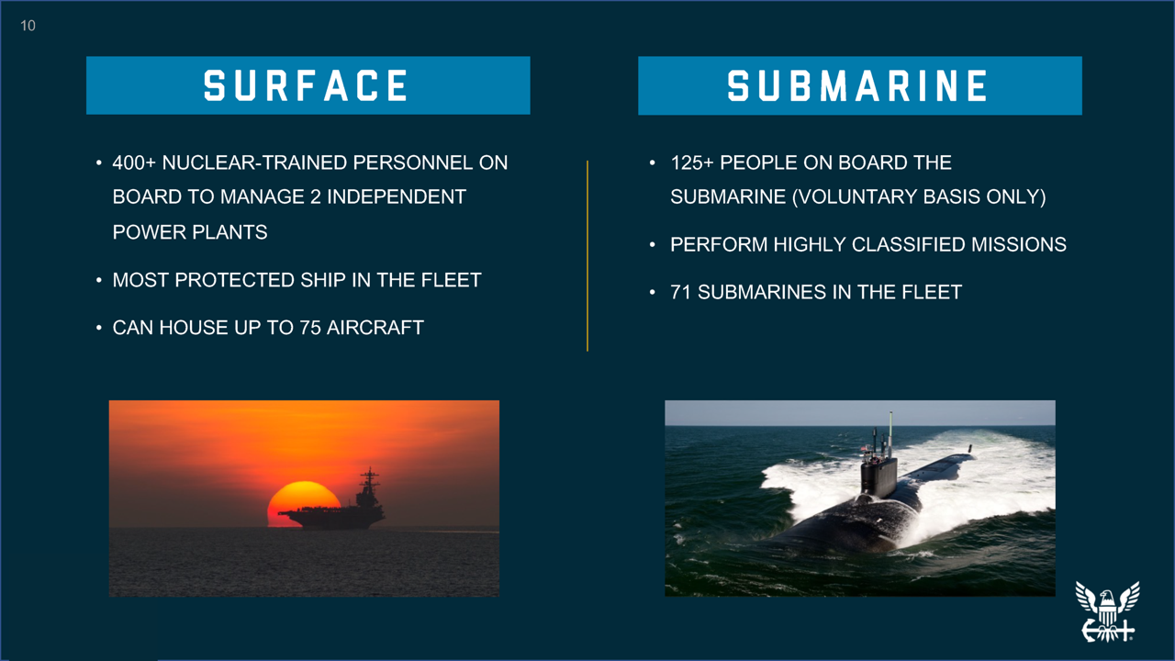

Slide 11
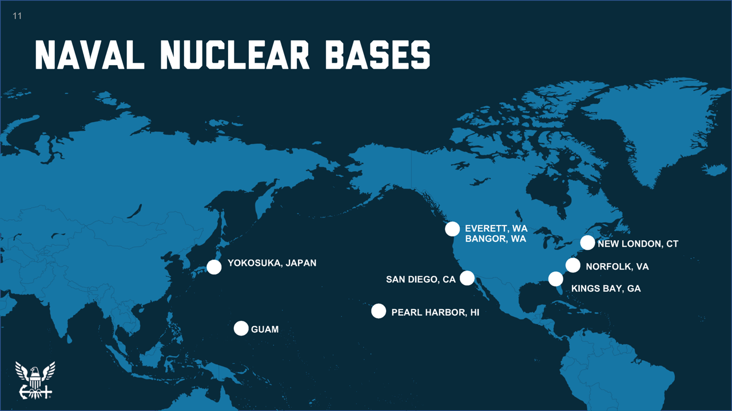
Notes:
Here are the eight bases where you could potentially be stationed.
(Feel free to add context or color to the slide.)

Slide 12


Slide 13


Slide 14
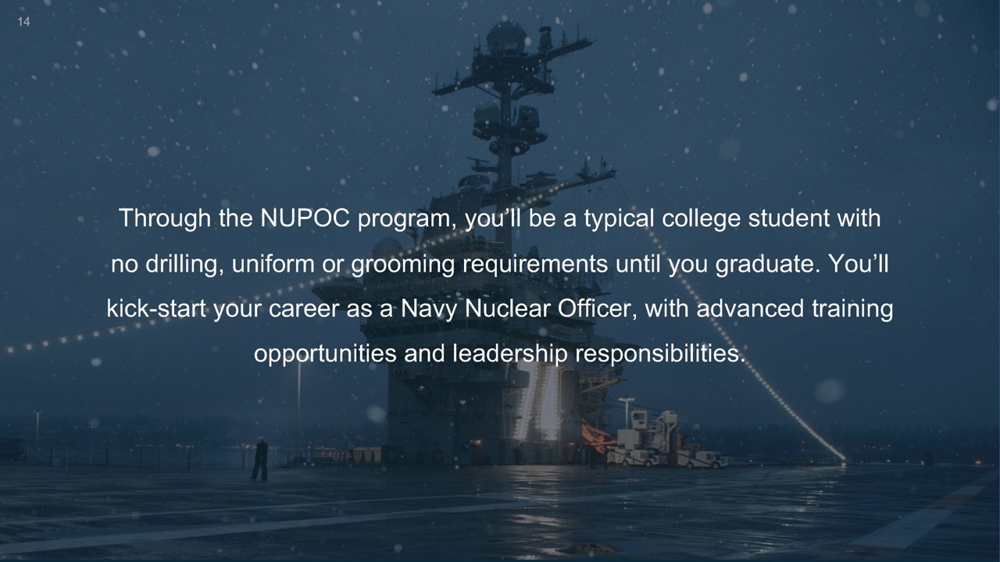

Slide 15


Slide 16
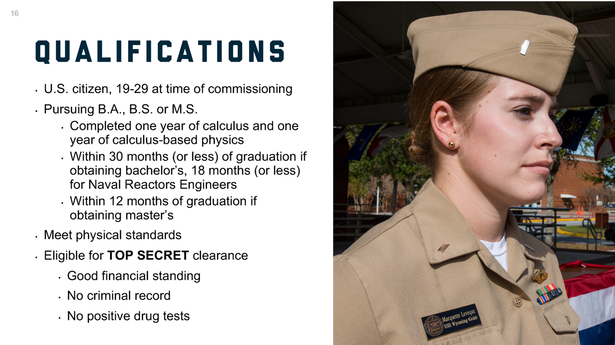

Slide 17
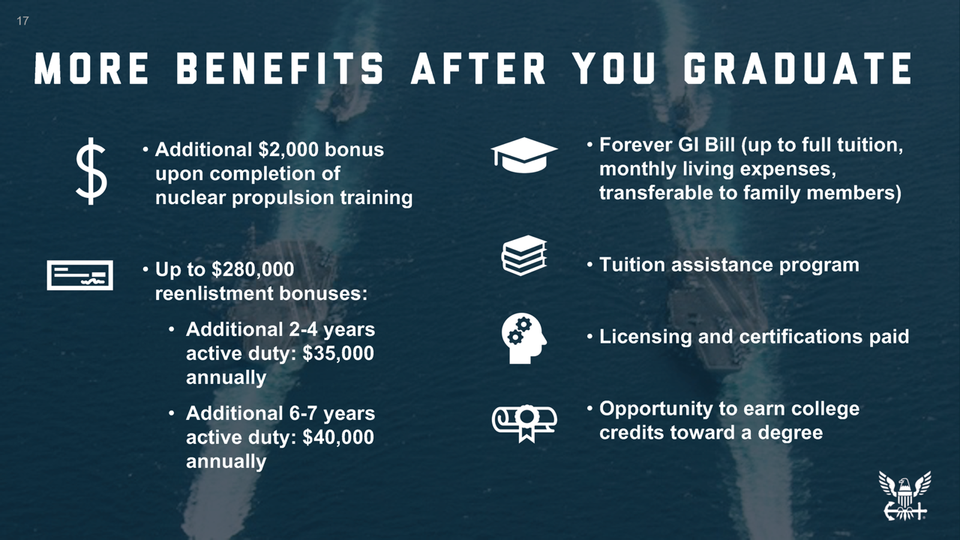

Slide 18
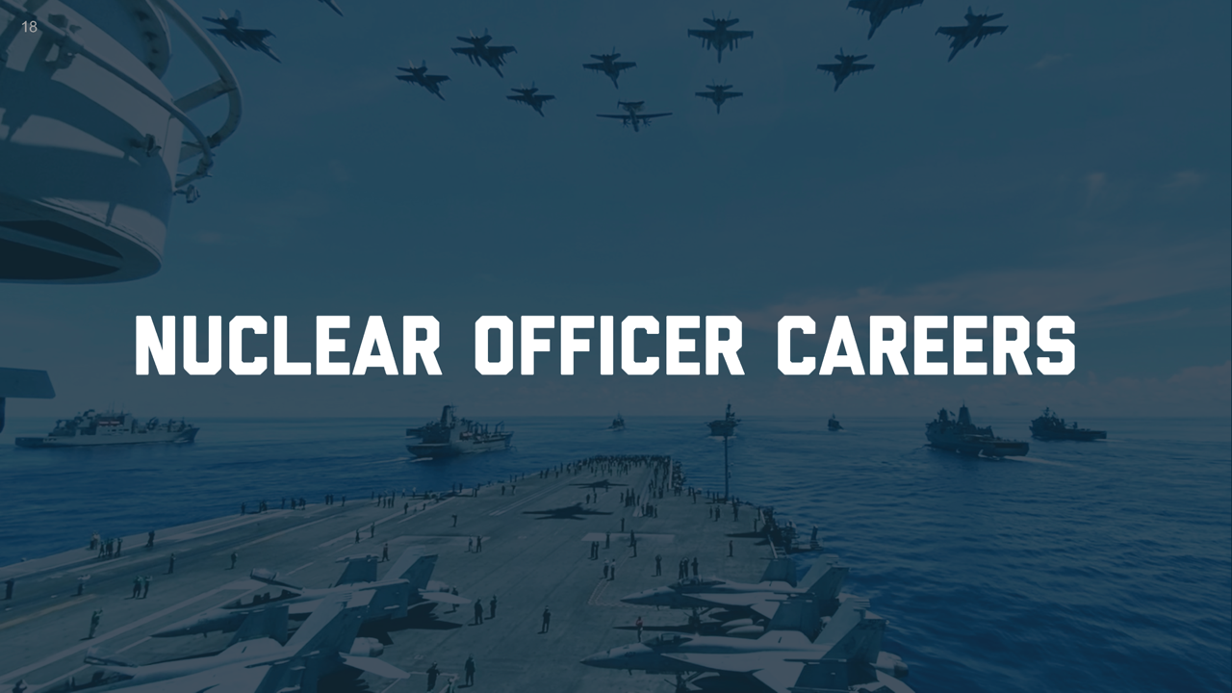

Slide 19
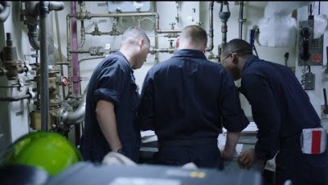
19

Slide 20
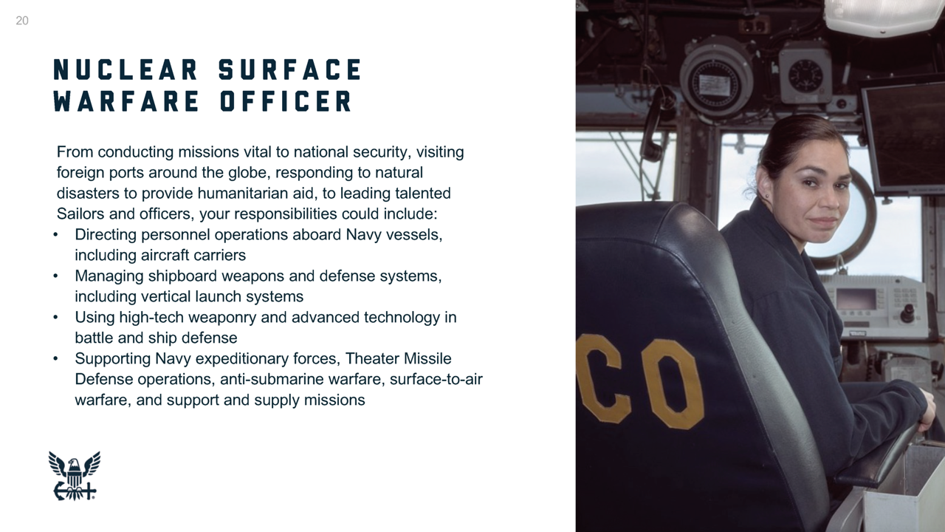

Slide 21
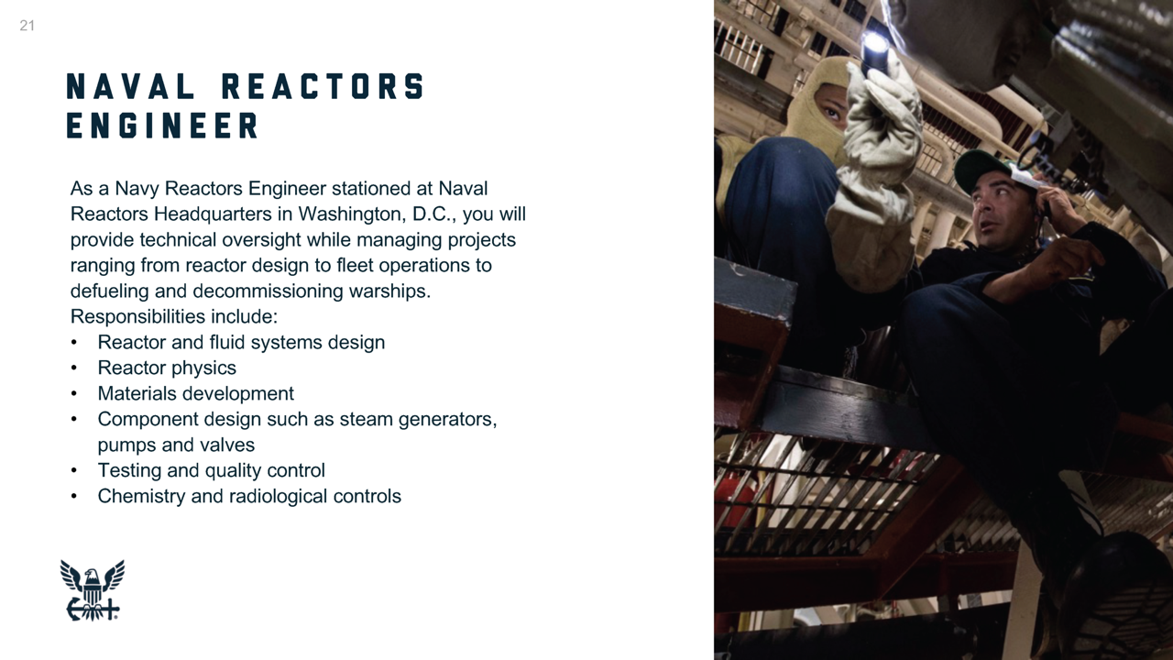

Slide 22
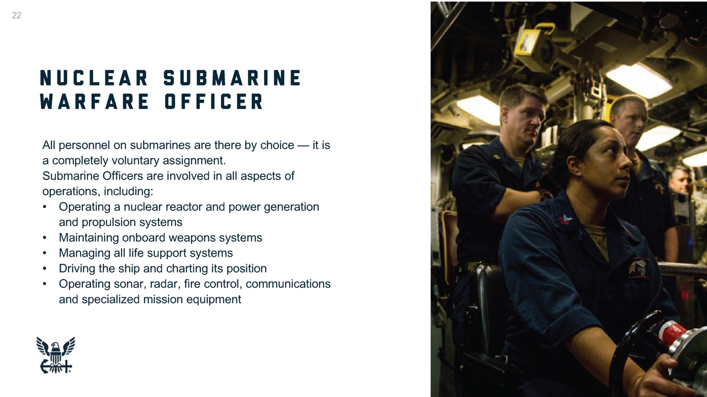

Slide 23

23

Slide 24


Slide 25
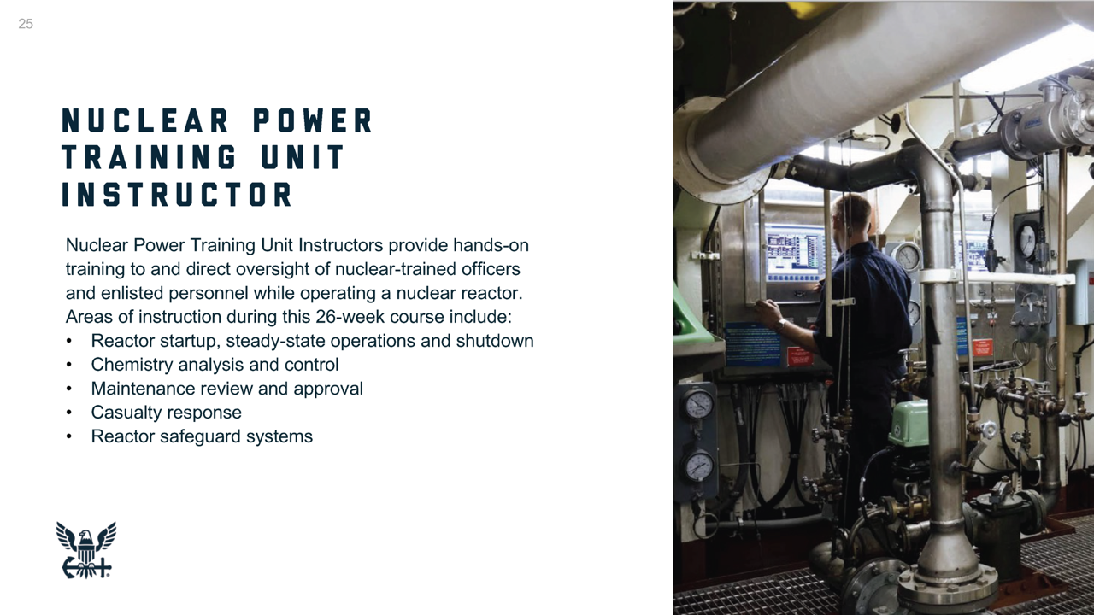

Slide 26
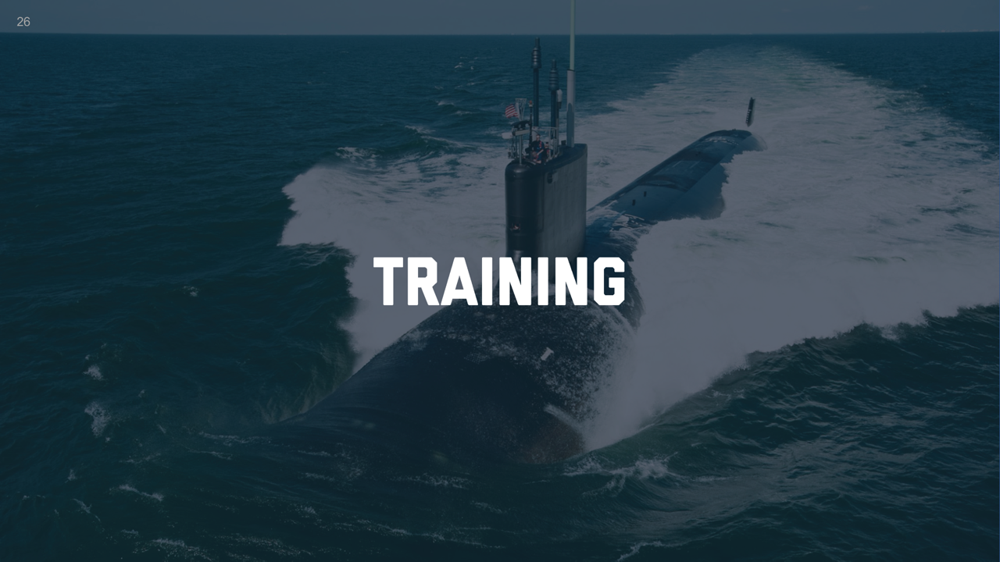
Notes:
The nuclear program isn’t easy. It’s actually the toughest academic program across all military platforms.

Slide 27
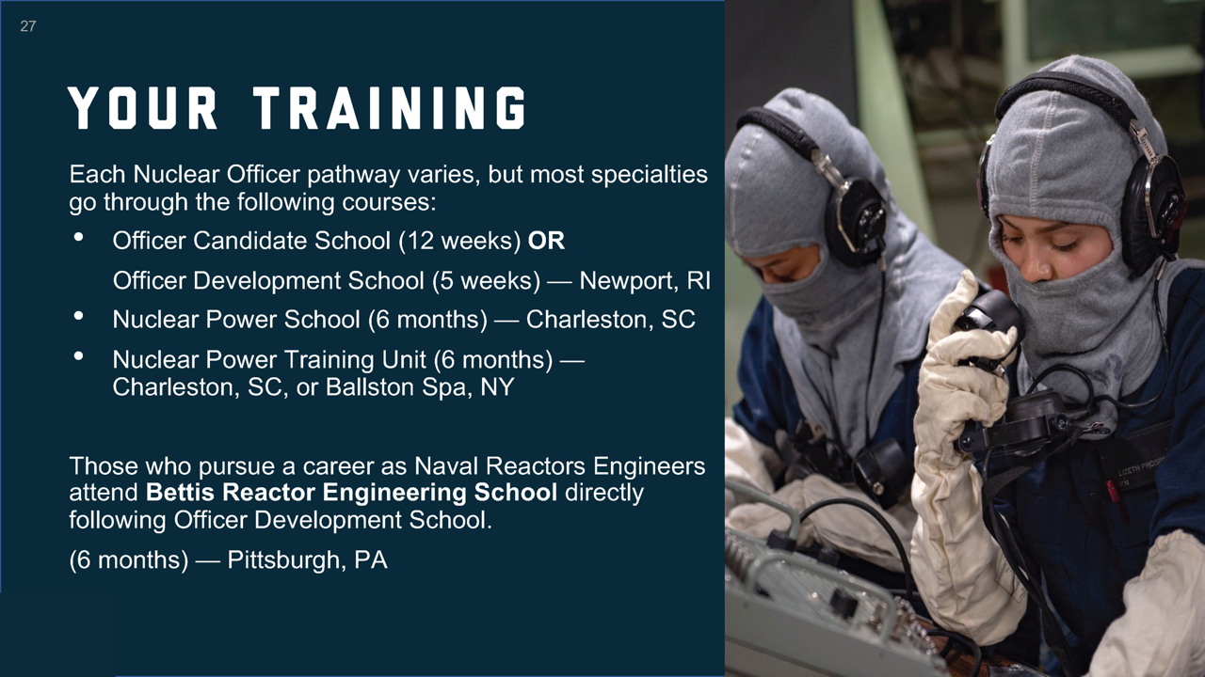
Notes:
You’ll receive training on a curriculum designed by MIT.
All while receiving a paycheck.

Slide 28
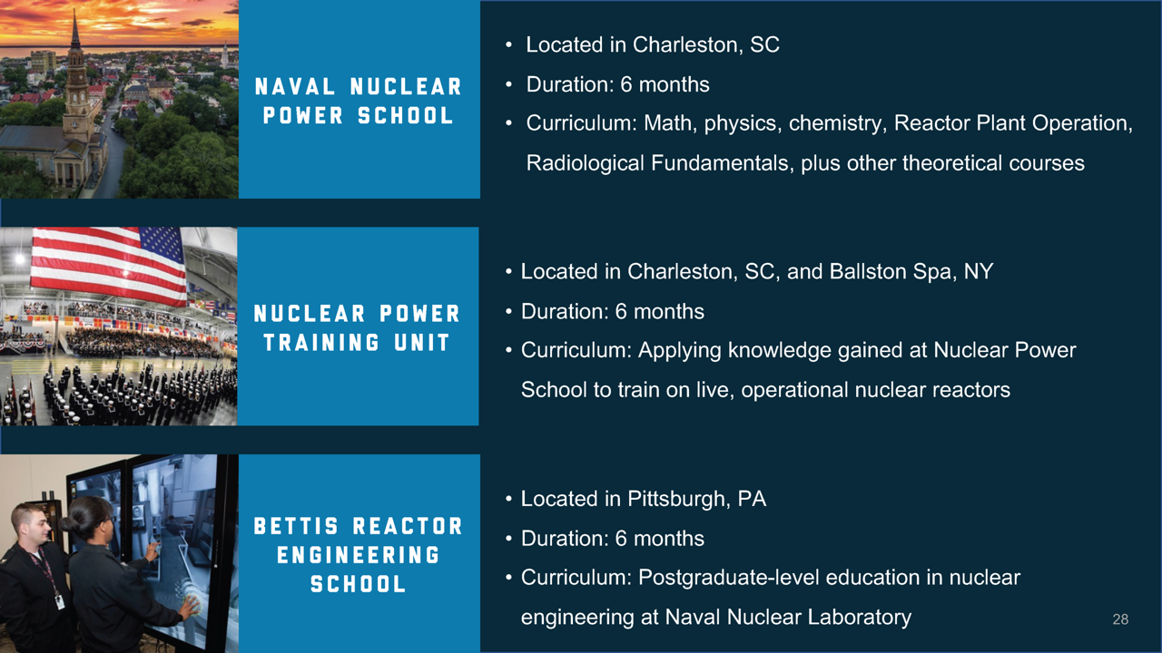

Slide 29
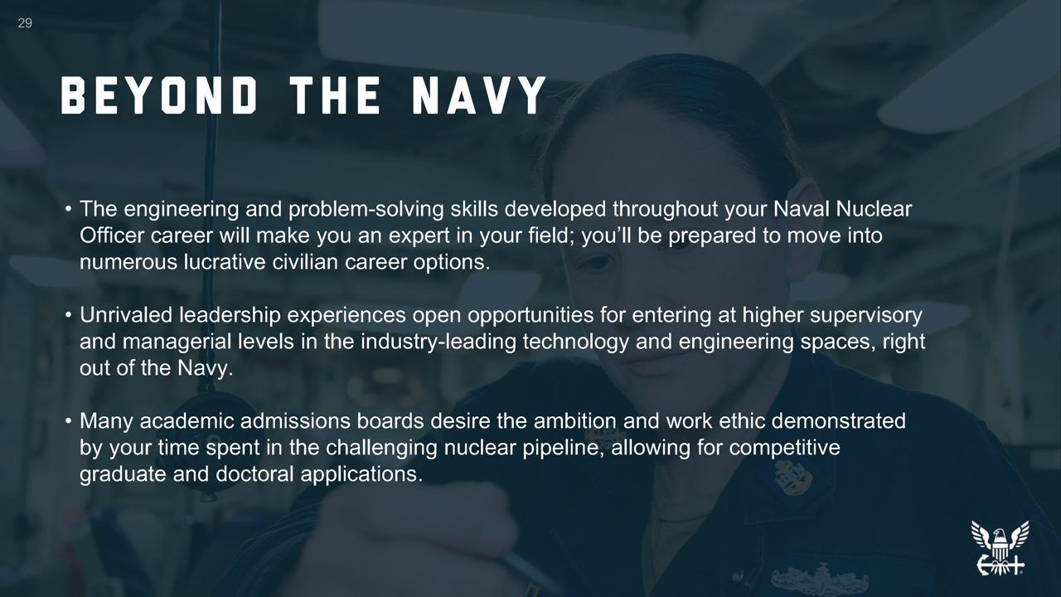
Notes:
You are setting yourself up for the future. Here is what you may expect once you leave the Navy.
Some find that the most difficult decision they may have to make after the Navy is where to live and work because there are so many opportunities.

Slide 30
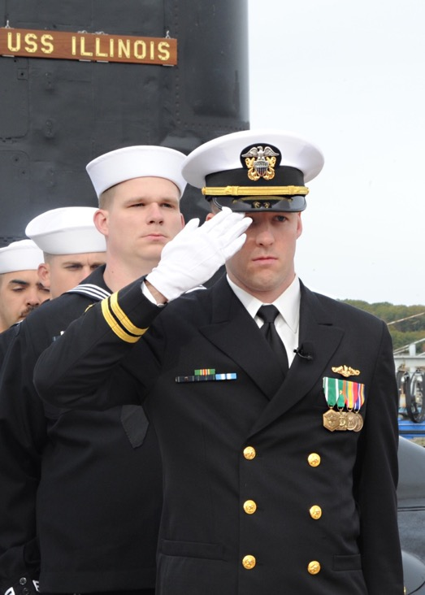
30
WANT MORE INFO?
America’s Navy www.navy.com
U.S. Department of Energy www.energy.gov
Nuclear Regulatory Commission www.nrc.gov
World Nuclear Association www.world-nuclear.org
Notes:
Here are some additional resources for you, including Navy.com, which has a wealth of information about the Navy.

Slide 31
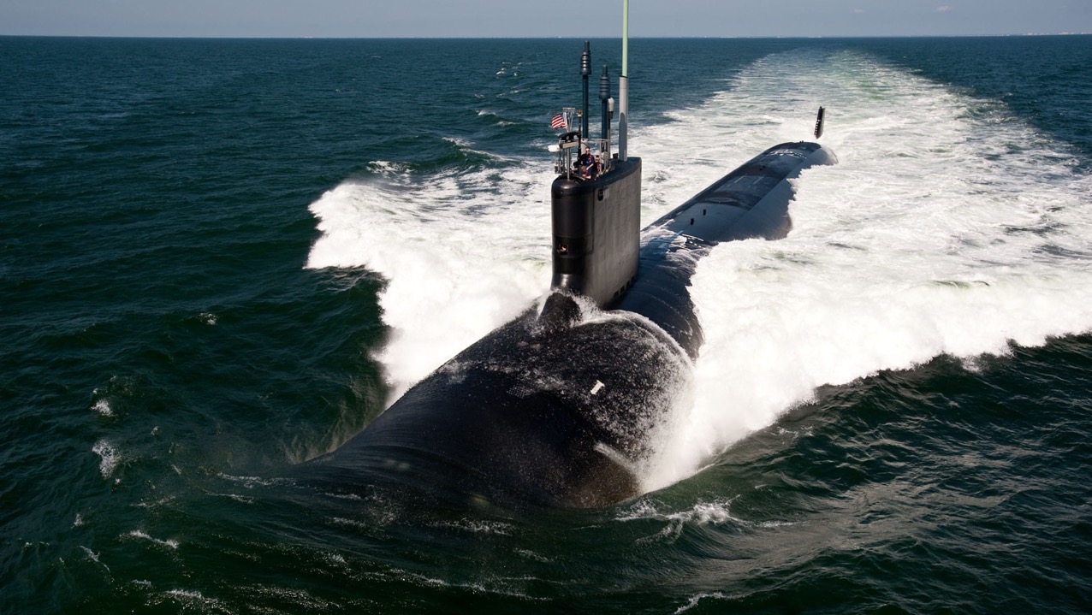
Questions?
CONTACT INFO:
Notes:
Talk to me! I’d love to tell you more about life in the Navy and answer any questions you may have.
(Input your contact information — phone, email, social media handles, and/or your personalized QR or Snapchat code.)
(If inserting a code, encourage students to take a picture and save your contact information.)

